Slide 1
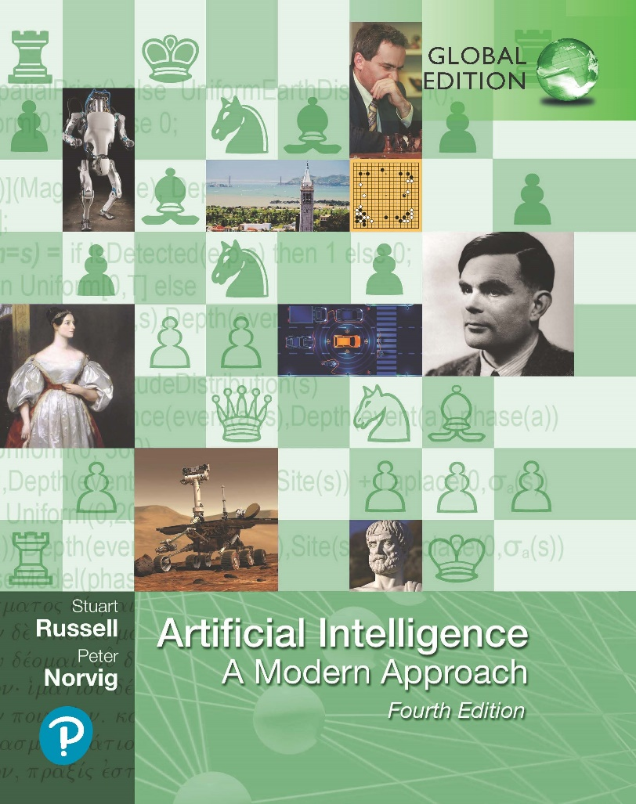
Artificial Intelligence: A Modern Approach
Fourth Edition, Global Edition
Chapter 29
The Future Of AI
© 2022 Pearson Education Ltd.

Slide 2
Outline
AI Components
AI Architectures

Slide 3
AI Components
Sensors and actuators
direct access to the world has been absent
AI systems were built in such a way that humans had to supply the inputs and interpret the outputs.
The demand for better image processing in cellphone cameras has given us inexpensive high-resolution cameras for use in robotics
MEMS (micro-electromechanical systems) technology has supplied miniaturized accelerometers, gyroscopes, and actuators small enough to fit in artificial flying insects
AI systems are at the cusp of moving from primarily software-only systems to useful embedded robotic system
intelligent robots will first make strides in industry before the home market

Slide 4
AI Components
Representing the state of the world
Keeping track of the world requires perception as well as updating of internal representations
Current filtering and perception algorithms can be combined to do a reasonable job of recognizing objects and reporting low-level predicates
Future progress will require techniques that generalize to novel situations without requiring exhaustive examples
word embeddings and similar representations can free us from the strict bounds of concepts defined by necessary and sufficient condition
However it remains a daunting task to define general, reusable representation schemes for complex domains.

Slide 5
AI Components
Selecting actions
The primary difficulty in action selection in the real world is coping with long-term plans
Humans apply hierarchical structure on behavior
hierarchical reinforcement learning has succeeded in combining these ideas with the MDP formalism
these methods have not been extended to the partially observable case (POMDPs).
Deciding what we want
the task of picking the right utility function is a challenging problem
do not yet have much experience with building complex real-world preference models, let alone probability distributions over such models.
Inverse reinforcement learning is one approach when we have an expert who can perform a task, but not explain it.
We need better ways of saying what we want and better ways for robots to interpret the information we provide.
powerful ecosystem for aggregating user preferences but fail to provide an easy way of opting out
in the future we will have personal agents that stick up for our true long-term interests

Slide 6
AI Components
Learning
Current algorithms can cope with quite large problems, reaching or exceeding human capabilities in many task
learning can stall when data are sparse, or unsupervised, or when we are dealing with complex representation
need advances in transfer learning so that we can take advantage of data in one domain to improve performance on a related domain
The vast majority of machine learning research today assumes a factored representation

Slide 7
AI Components
Resources
Machine learning research and development has been accelerated by the increasing availability of data, storage, processing power, software, trained experts, and the investments needed to support them
Hundreds of high-quality data sets are available for a range of tasks in computer vision, speech recognition, and natural language processing.
There is a possibility that quantum computers could accelerate AI.
Currently there are some fast quantum algorithms for the linear algebra operations used in machine learning
Current quantum computers handle only a few tens of bits, whereas machine learning algorithms often handle inputs with millions of bits and create models with hundreds of millions of parameters.

Slide 8
AI Architectures
AI has long had a split between symbolic systems (based on logical and probabilistic inference) and connectionist systems (based on loss minimization over a large number of uninterpreted parameters).
Agents need ways to control their own deliberations
use the available time well
cease deliberating when action is demanded
anytime algorithms
an algorithm whose output quality improves gradually over time, so that it has a reasonable decision ready whenever it is interrupted
Decision-theoretic metareasoning
applies the theory of information value to the selection of individual computations
Metareasoning techniques can be used to design better search algorithms and to guarantee that the algorithms have the anytime property
Reflective architecture: an architecture that enables deliberation about the computational entities and actions occurring within the architecture itself.

Slide 9
AI Architectures
General AI
Much of the progress in AI in the 21st century so far has been guided by competition on narrow tasks, such as the DARPA Grand Challenge for autonomous cars, the ImageNet object recognition competition
Continued work on specific tasks (or on individual components) will not be enough to reach mastery on a wide variety of tasks
AI as a field has made a reasonable exploration/exploitation tradeoff, assembling a portfolio of components, improving on particular tasks, while also exploring promising and sometimes far-out new ideas.
Work on components can spur new ideas; for example, generative adversarial networks (GANs) and transformer language models each opened up new areas of research.

Slide 10
AI Architectures
AI engineering
The AI industry has not yet reached that level of maturity.
We do have a variety of powerful tools and frameworks, such as TensorFlow, Keras, PyTorch, CAFFE, Scikit-Learn and SCIPY.
But many of the most promising approaches, such as GANs and deep reinforcement learning, have proven to be difficult to work with—they require experience and a degree of fiddling to get them to train properly in a new domain
start with a single huge system and, for each new task, extract from it the parts that are relevant to the task

Slide 11
AI Architectures
The future
AI seems to fit in with other powerful revolutionary technologies such as printing, plumbing, air travel, and telephony.
AI is different from previous revolutionary technologies.
Improving printing, plumbing, air travel, and telephony to their logical limits would not produce anything to threaten human supremacy in the world.
Improving AI to its logical limit certainly could.
In conclusion, AI has made great progress in its short history, but the final sentence of Alan Turing’s (1950) essay on Computing Machinery and Intelligence is still valid today:
We can see only a short distance ahead,
but we can see that much remains to be done.

